Slide 1
GRADE 1-EVS
TYPES OF FAMILIES
Presented by
. B. Jehanya
CLT Primary coordinator
SNS Academy
GRADE 1 / EVS / TYPES OF FAMILIES-JOINT FAMILY / JEHANYA.B
07.08.2020

Slide 2
JOINT FAMILY
Joint family is a family where members like grandparents, parents, uncle, aunt and cousins live together in one house.
Many members live together in a joint family.
It’s a big family.
GRADE 1 / EVS / TYPES OF FAMILIES-JOINT FAMILY / JEHANYA.B

Slide 3
Joint families

Slide 4
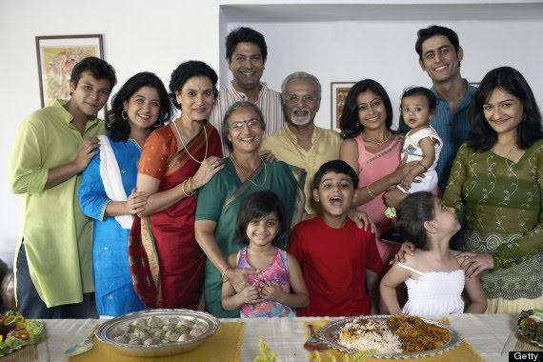
So, in a joint family :
Children live with their father, mother, grandparents, uncle, aunt and cousins.

